Slide 1
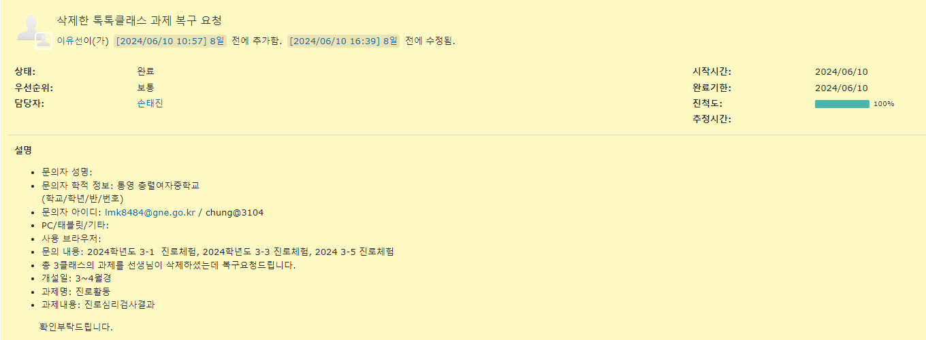
삭제 시 USE_AT 같은 컬럼 사용하는 이유

Slide 2
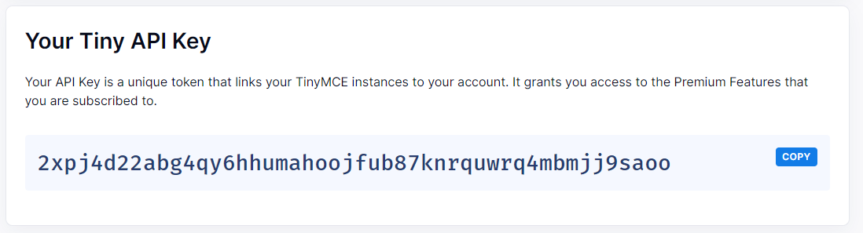
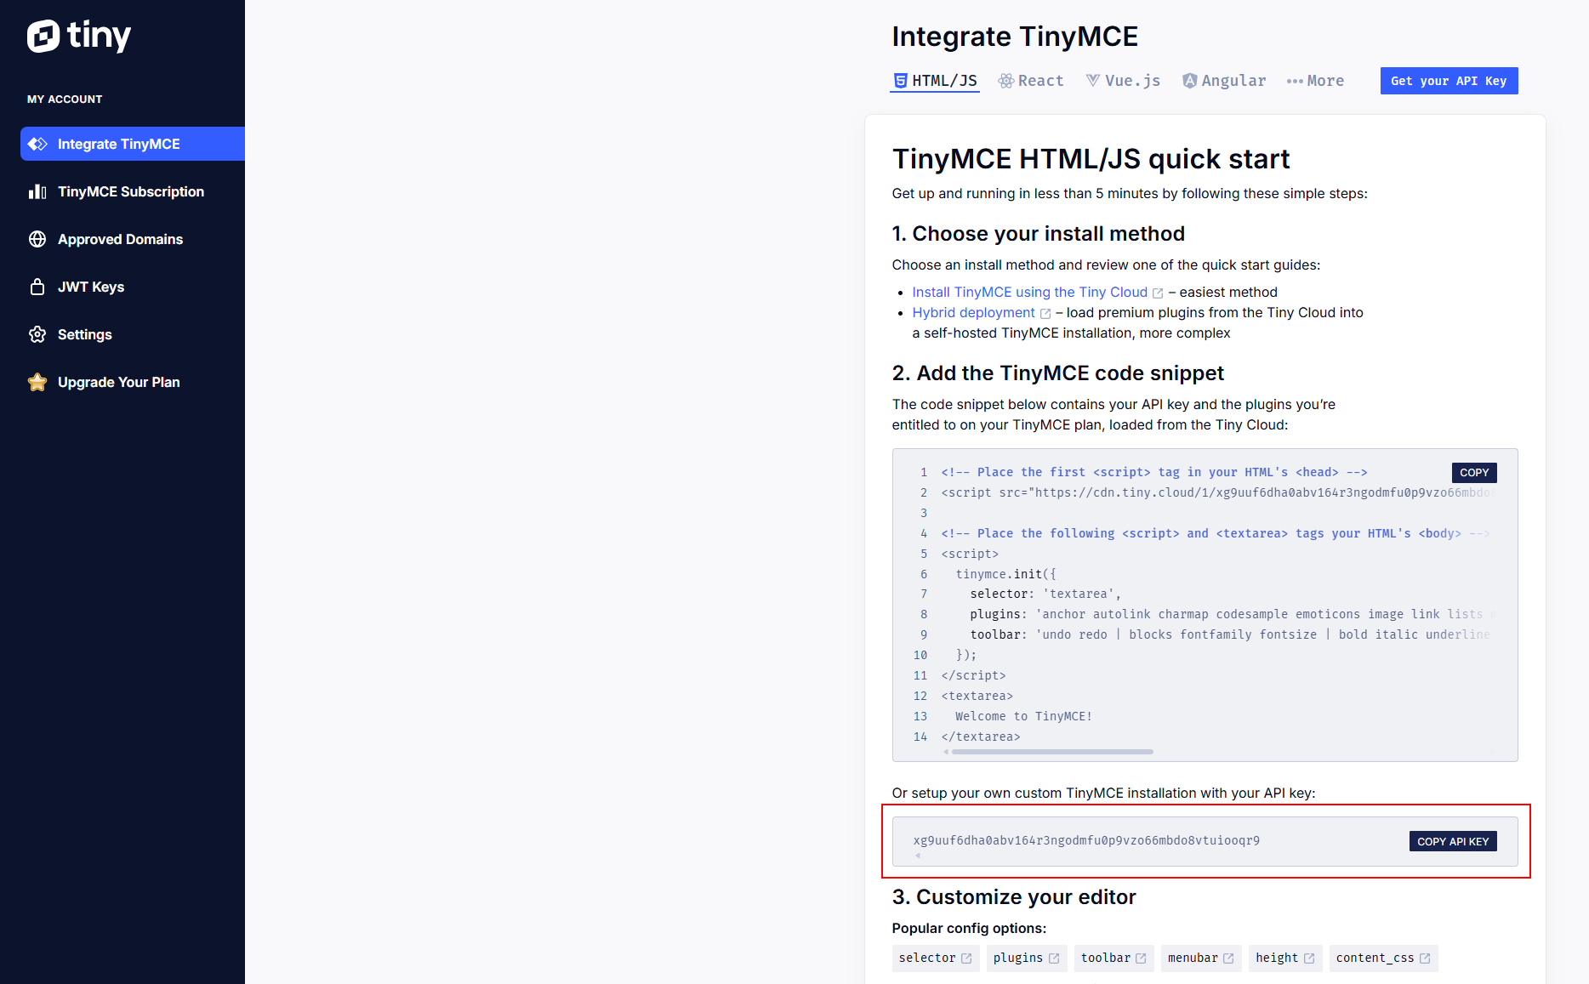
https://www.tiny.cloud/

Slide 3
function regist()에 추가 ← 안 해도 무관
//에디터 내용 저장
$("#boardCn").val(tinymce.activeEditor.getContent());

Slide 4
<script src="https://cdn.tiny.cloud/1/2xpj4d22abg4qy6hhumahoojfub87knrquwrq4mbmjj9saoo/tinymce/6/tinymce.min.js" referrerpolicy="origin"></script>
<script>
$(function(){
var plugins = [
"advlist", "autolink", "lists", "link", "image", "charmap", "print", "preview", "anchor",
"searchreplace", "visualblocks", "code", "fullscreen", "insertdatetime", "media", "table",
"paste", "code", "help", "wordcount", "save"
];
var edit_toolbar = 'formatselect fontselect fontsizeselect |'
+ ' forecolor backcolor |'
+ ' bold italic underline strikethrough |'
+ ' alignjustify alignleft aligncenter alignright |'
+ ' bullist numlist |'
+ ' table tabledelete |'
+ ' link image';
tinymce.init({
language: "ko_KR", //한글판으로 변경
selector: '#boardCn',
height: 500,
menubar: false,
plugins: plugins,
toolbar: edit_toolbar,
/*** image upload ***/
image_title: true,
/* enable automatic uploads of images represented by blob or data URIs*/
automatic_uploads: true,
/*
URL of our upload handler (for more details check: https://www.tiny.cloud/docs/configure/file-image-upload/#images_upload_url)
images_upload_url: 'postAcceptor.php',
here we add custom filepicker only to Image dialog
*/
file_picker_types: 'image',
/* and here's our custom image picker*/
file_picker_callback: function (cb, value, meta) {
var input = document.createElement('input');
input.setAttribute('type', 'file');
input.setAttribute('accept', 'image/*');
/*
Note: In modern browsers input[type="file"] is functional without
even adding it to the DOM, but that might not be the case in some older
or quirky browsers like IE, so you might want to add it to the DOM
just in case, and visually hide it. And do not forget do remove it
once you do not need it anymore.
*/
input.onchange = function () {
var file = this.files[0];
var reader = new FileReader();
reader.onload = function () {
/*
Note: Now we need to register the blob in TinyMCEs image blob
registry. In the next release this part hopefully won't be
necessary, as we are looking to handle it internally.
*/
var id = 'blobid' + (new Date()).getTime();
var blobCache = tinymce.activeEditor.editorUpload.blobCache;
var base64 = reader.result.split(',')[1];
var blobInfo = blobCache.create(id, file, base64);
blobCache.add(blobInfo);
/* call the callback and populate the Title field with the file name */
cb(blobInfo.blobUri(), { title: file.name });
};
reader.readAsDataURL(file);
};
input.click();
},
/*** image upload ***/
content_style: 'body { font-family:Helvetica,Arial,sans-serif; font-size:14px }'
});
});
</script>

Slide 5
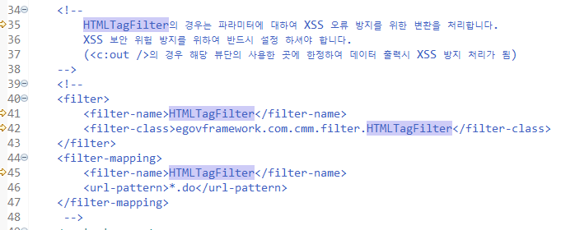
web.xml에서 HTML태그필터 주석처리

Slide 6
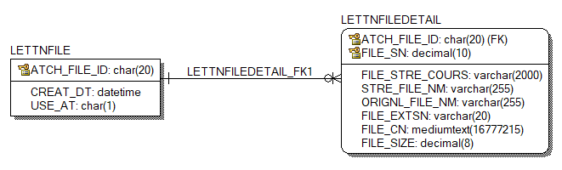
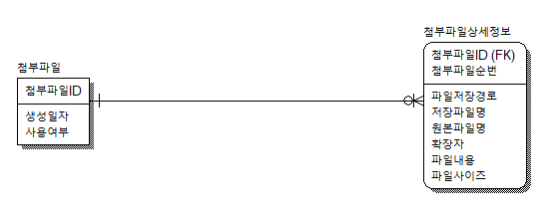
<논리>
<물리>

Slide 7
globals.properties
# file경로(내 워크스페이스 경로)
Globals.File = D:/JAVA_PROJECTS/kopo/2024/homepage/workspace/.metadata/.plugins/org.eclipse.wst.server.core/tmp0/wtpwebapps/homepage2024

Slide 8
context-properties.xml
<entry key="board.fileStorePath" value="${Globals.File}/upload/board"/>

Slide 9
BoardRegist
1. <form action="${actionUrl}" method="post" …. enctype="multipart/form-data">
2. <input type="hidden" name="returnUrl" value="/board/boardRegist.do"/>
3. <c:if test="${not empty result.atchFileId}">
<tr>
<th scope="row">기존 첨부파일목록</th>
<td>
<c:import url="/cmm/fms/selectFileInfsForUpdate.do" charEncoding="utf-8">
<c:param name="param_atchFileId" value="${result.atchFileId}" />
</c:import>
</td>
</tr>
</c:if>
<tr>
<th scope="row">파일첨부</th>
<td>
<input type="file" name="file_1"/><br/>
<input type="file" name="file_2"/>
</td>
</tr>

Slide 10
BoardController
1. @Resource(name = "EgovFileMngService")
private EgovFileMngService fileMngService;
@Resource(name = "fileMngUtil")
private FileMngUtil fileUtil;
2. public String insert(final MultipartHttpServletRequest multiRequest,….) throws Exception{
3. 등록 부분
List<FileVO> result = null;
String atchFileId = "";
final Map<String, MultipartFile> files = multiRequest.getFileMap();
if(!files.isEmpty()) {
result = fileUtil.parseFileInf(files, "BOARD_", 0, "", "board.fileStorePath");
atchFileId = fileMngService.insertFileInfs(result);
}
searchVO.setAtchFileId(atchFileId);

Slide 11
BoardController
업데이트 부분
String atchFileId = searchVO.getAtchFileId();
final Map<String, MultipartFile> files = multiRequest.getFileMap();
if(!files.isEmpty()) {
if(EgovStringUtil.isEmpty(atchFileId)) {
List<FileVO> result = fileUtil.parseFileInf(files, "BOARD_", 0, "", "board.fileStorePath");
atchFileId = fileMngService.insertFileInfs(result);
searchVO.setAtchFileId(atchFileId);
}else {
FileVO fvo = new FileVO();
fvo.setAtchFileId(atchFileId);
int cnt = fileMngService.getMaxFileSN(fvo);
List<FileVO> _result = fileUtil.parseFileInf(files, "BOARD_", cnt, atchFileId, "board.fileStorePath");
fileMngService.updateFileInfs(_result);
}
}

Slide 12
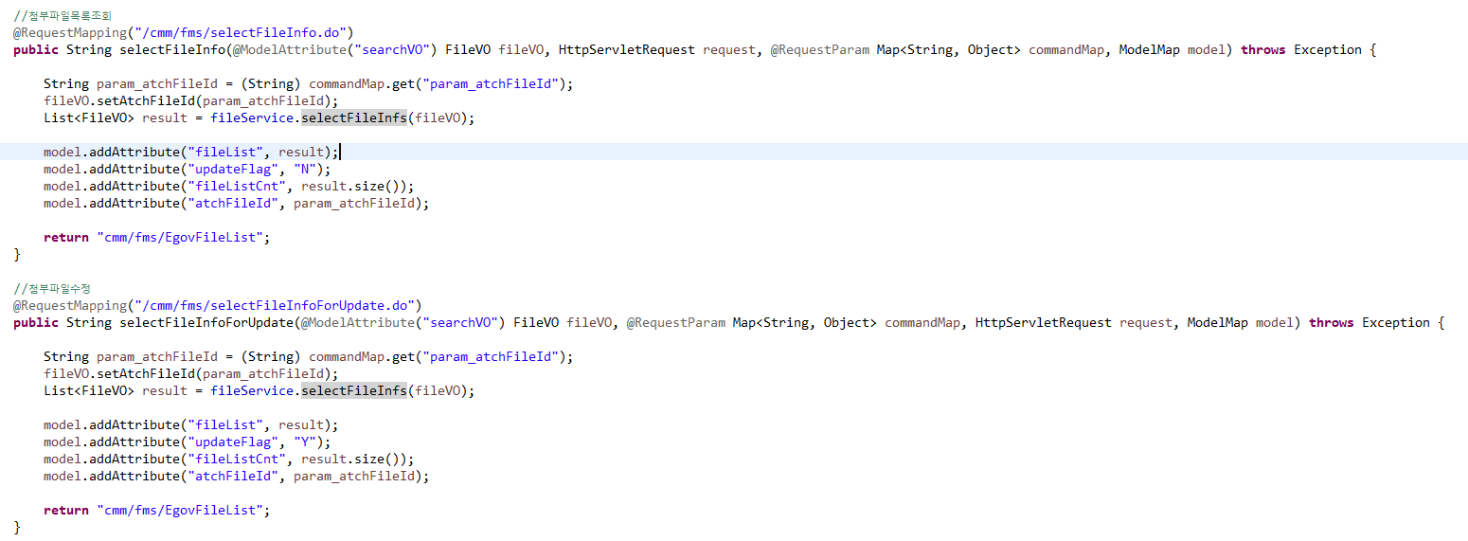
EgovFileMngController에 첨부파일목록조회, 첨부파일수정 부분 추가

Slide 13
EgovFileList
파일 내용 전체 수정

Slide 14
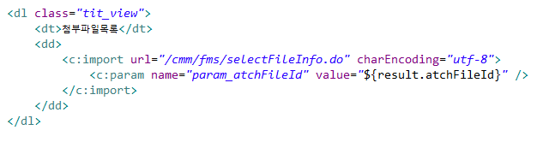
BoardSelect
아래 내용 추가

Slide 15
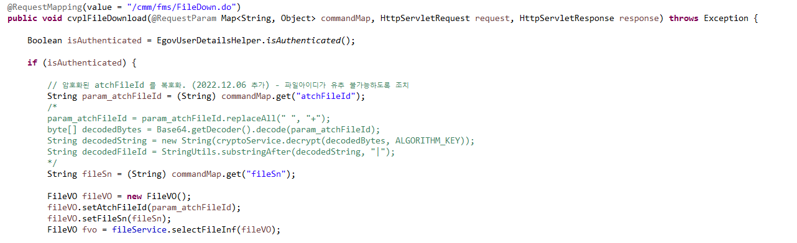
EgovFileDownloadController
암호화 처리되는 부분 주석처리
암호화 부분을 파라미터 받는걸로 처리

Slide 16
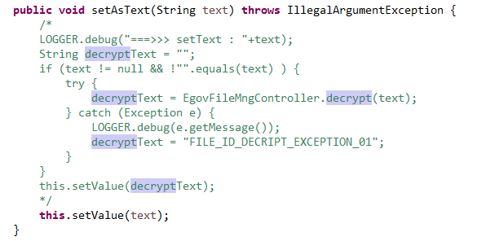
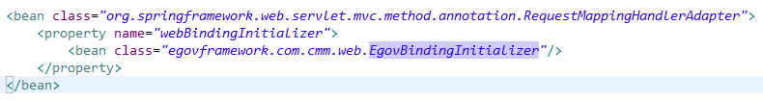
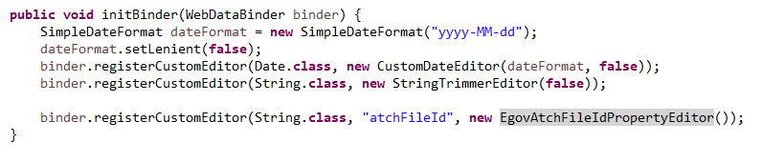
EgovAtchFileIdPropertyEditor 암호화 부분 주석처리 후 set부분 추가
egov-com-servlet.xml에 atchFileId 암호화 처리하게 되어져 있어서 EgovAtchFileIdPropertyEditor암호화 처리하는 부분 주석처리 해야 함(업데이트 시 필요)

Slide 17
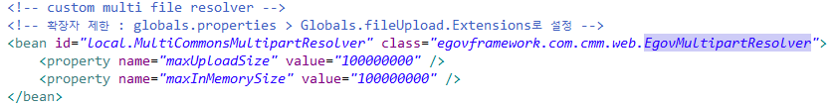

파일 확장자 체크
context-common.xml
globals.properties에 pdf파일 추가 후 잘 등록되는지 확인

Slide 18
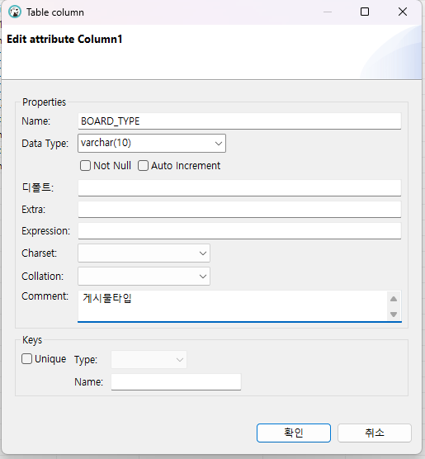
디비버로 BOARD_TYPE 추가
UPDATE BOARD SET
BOARD_TYPE = 'NORMAL'

Slide 19
context-properties.xml
<entry key="photoThumbWidth" value="200"/>
<entry key="photoThumbHeight" value="140"/>

Slide 20
pom
<!-- 썸네일 -->
<dependency>
<groupId>net.coobird</groupId>
<artifactId>thumbnailator</artifactId>
<version>0.4.2</version>
</dependency>

Slide 21
EgovImageProcessController
/cmm/fms/getThumbImage.do 어노테이션 관련 추가

Slide 22
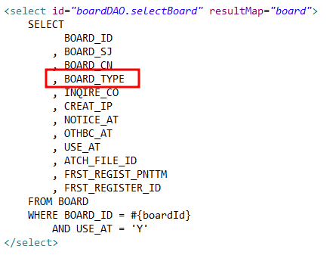
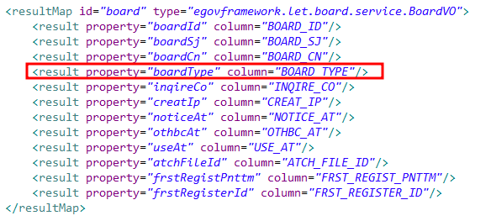
Board_SQL
, (SELECT
CONCAT(X.STRE_FILE_NM, '.', X.FILE_EXTSN)
FROM LETTNFILEDETAIL X
WHERE X.ATCH_FILE_ID = A.ATCH_FILE_ID
AND UPPER(FILE_EXTSN) IN ('GIF','JPG','JPEG','BMP','PNG')
ORDER BY FILE_SN
LIMIT 1
) AS ATCH_FILE_NM

Slide 23
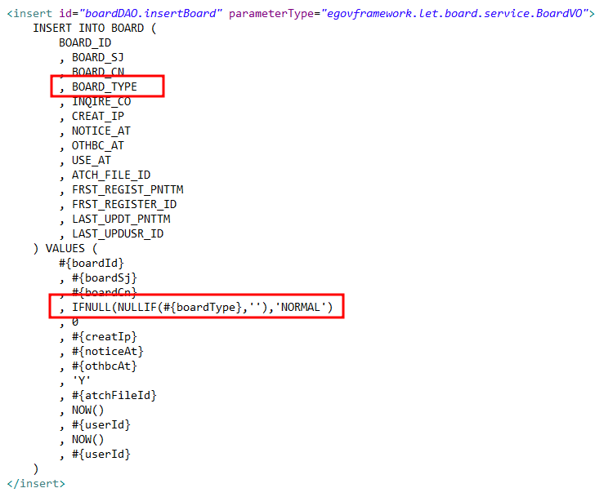
Board_SQL

Slide 24
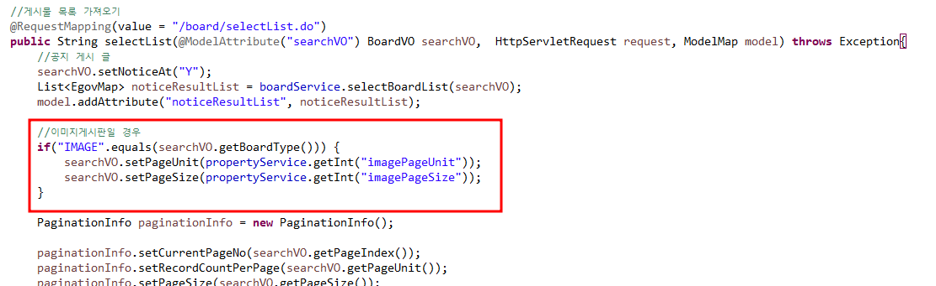
BoardController

Slide 25
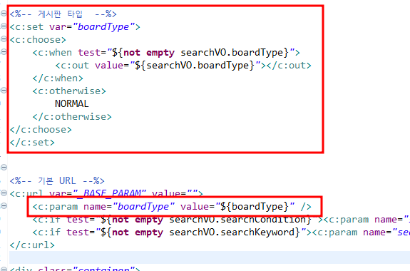
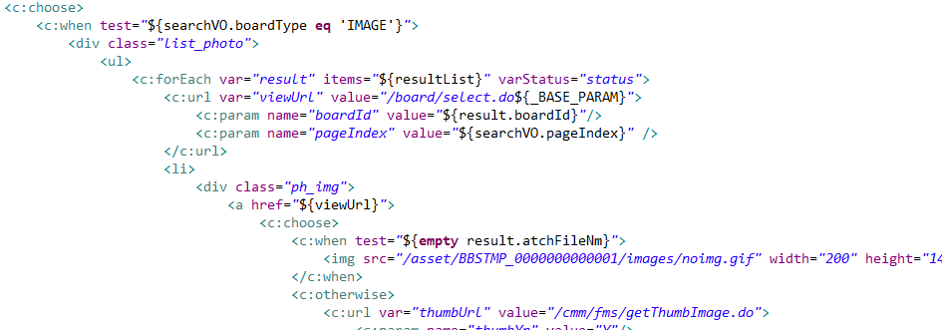
BoardSelectList
기존 게시판 c:choose로 변경

Slide 26
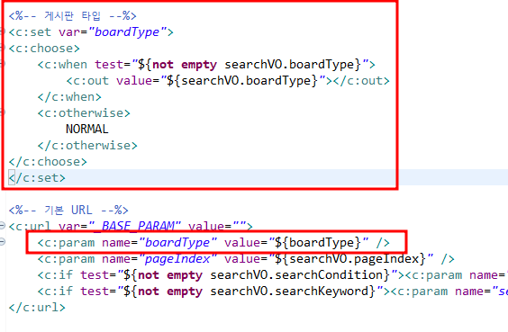
BoardSelect

Slide 27
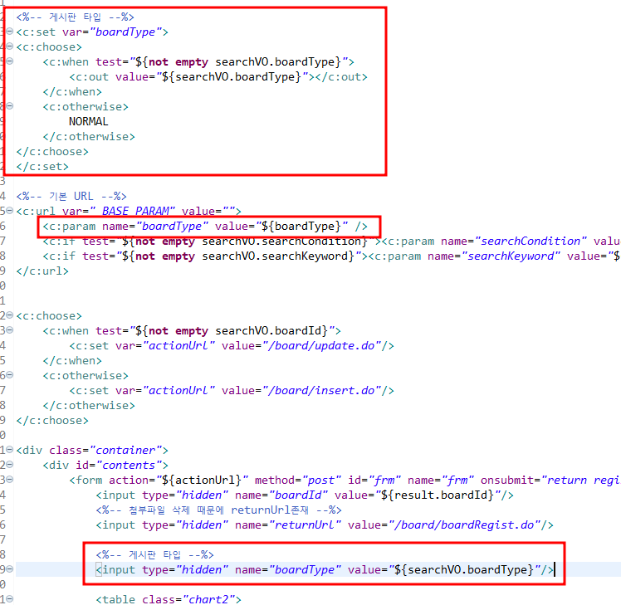
BoardRegist

